Slide 1

Childhood Risk and Resilience Factors for Pasifika Youth Respiratory Health: Accounting for Attrition and Missingness
Siwei Zhai (szha580@aucklanduni.ac.nz) Main supervisor: A/Prof Alain C. Vandal Co-supervisors: Prof Catherine A. Byrnes (Respiratory expert, Department of Paediatrics, FMHS, UoA) , A/Prof El-Shadan Tautolo (AUT Pacific Health Research Centre) Co-authors: Dr Conroy Wong (Respiratory expert, Te Whatu Ora Counties Manukau, UoA), Leon Iusitini (AUT), Dr Shabnam Jalili – Moghaddam (AUT) November 2025
Notes:
Hello, I am Siwei Zhai, a third year PhD student from University of Auckland. My topic is Childhood Risk and Resilience Factors for Pasifika Youth Respiratory Health: Accounting for Attrition and Missingness
Our research team includes Alain, Dan, Cass, Conroy, Leon, and Shabnam.

Slide 2
Background – Respiratory Disease and Pasifika People
In New Zealand, 7% of deaths are related to respiratory diseases (Riley, L., & Cowan, M. 2014).
People living in the most deprived NZDep quintiles (1-2) have higher hospitalisation rates and greater mortality from respiratory disease than those in the least deprived NZDep quintiles (9-10). However, 74% of the Pacific population lives in the country’s most deprived areas.
Pacific People have a 2.6 times higher hospitalisation rate for respiratory disease than other ethnic groups over all age groups, with relative risks between 1.7 and 18.2 for different lung disorders compared to non-Pacific People.
Notes:
From the WHO report in 2014, 7% of deaths are related to respiratory diseases in New Zealand, and research showed that people living in the most deprived NZDep quintiles have higher hospitalisations and greater mortality from respiratory disease than those in the least deprived NZDep quintiles.
However, 74% of the Pacific population lives in the country’s most deprived areas. So, they are at higher risk.
--
Pacific People had a 2.6 times higher hospitalization rate for respiratory disease compared to other ethnic groups over all age groups, with relative risks between 1.7 and 18.2 for different lung disorders compared to non-Pacific people.

Slide 3
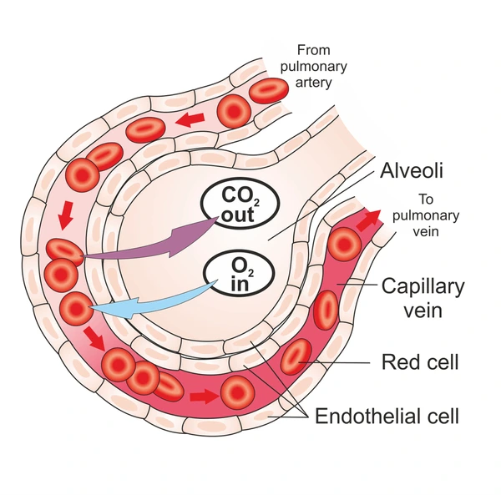
Background – Risks and Resilience Factors
Some research has shown that alveoli continue growing after two years of age and fully develop in early adulthood.
Risks on damaging lung function 1) Lung function reduction 2) Predisposition to later respiratory disease
Notes:
Some research showed that alveoli continue growing after two years of age and fully develops in early adulthood.
This could increase the likelihood of continued harm from new insults but also presents an opportunity to use resilience factors at different periods to improve later lung function.
The risks on damaging lung function includes lung function reduction and predisposition to later respiratory disease.
--
The former means that early insults may lower the maximum lung function and/or accelerate its decline after the peak and the latter means that early disease raises the risk of later disease occurring.

Slide 4

Background – PIFS cohort
The Pacific Islands Families study (PIFS) cohort consists of the 1,398 individuals born from Pacific Island families in Middlemore Hospital between March and December 2000 (Paterson et al., 2008).
Follow-up assessments occurred at birth and ages 1, 2, 4, 6, 9, 11, 14, and 18 years. 466 from the cohort participated in the respiratory study at 18 years.
Exposures come from 11 domains Immunisation, Exercise, Breastfeeding, Antenatal smoking, Smoking exposure, Smoking, Respiratory illness-infection, Body metrics, Nutrition, Allergies, Dwelling
Notes:
In our study, the major data comes from the Pacific Islands Families study cohort. It consists of 1,398 individuals born from Pacific Island families in Middlemore Hospital between March and December 2000.
Follow-up assessments were also conducted at different ages. The respiratory study was only conducted at 18 years and there were 466 participants from the cohort.
We have a bunch of related exposures in this study. They come from 11 domains.
These domains are highlighted by different colors based on findings from the relative research. Green indicates resilience factors that can improve lung function, Red represents risk factors that will harm lung function, and Orange factors can play either.

Slide 5
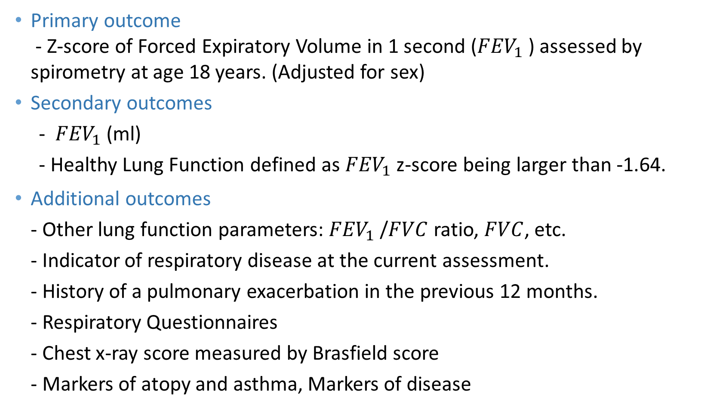
Background – Key Respiratory Outcomes
Primary outcome - Z-score of Forced Expiratory Volume in 1 second (${FEV}_{1}$ ) assessed by spirometry at age 18 years. (Adjusted for sex)
Secondary outcomes
- ${FEV}_{1}$ (ml)
- Healthy Lung Function defined as ${FEV}_{1}$ z-score being larger than -1.64.
Additional outcomes - Other lung function parameters: ${FEV}_{1}$ /$FVC$ ratio, $FVC$, etc. - Indicator of respiratory disease at the current assessment. - History of a pulmonary exacerbation in the previous 12 months. - Respiratory Questionnaires - Chest x-ray score measured by Brasfield score - Markers of atopy and asthma, Markers of disease
Notes:
In this study, the primary outcome is ${FEV}_{1}$ z-score, and the secondary outcomes are ${FEV}_{1}$ and Healthy Lung Function defined as ${FEV}_{1}$ z-score being larger than -1.64.
There are some additional outcomes in the PIFS cohort. We will also conduct an analysis on them.

Slide 6
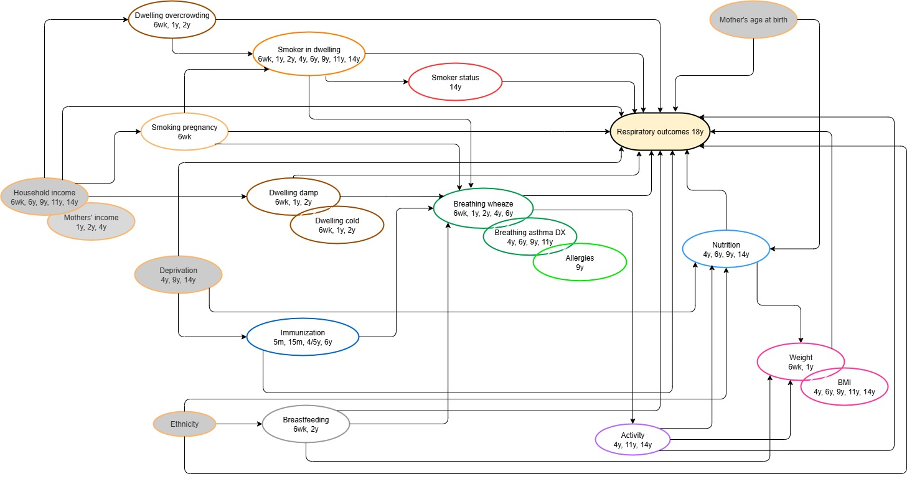
Background – Causal Diagram
Notes:
The causal diagram between the exposures of interest and the respiratory outcomes is also drawn and confirmed by respiratory health experts (Conroy and Cass).
--
My master thesis has explored the impact of nutrition factors and used inverse probability weighting to address selection bias. However, it is not a full respiratory analysis for Pasifika youth yet.

Slide 7
Methods – Inverse Probability Weighting (IPW)
What is Inverse probability weighting (IPW)? - Assumption: under non-MCAR mechanisms - Core calculation: Propensity scores to completeness - Fundamental idea: Pseudo-population - Suitable scenario: Suitable for scenarios involving a large number of missing responses or drop-outs within a longitudinal study.
Notes:
Missingness is a common issue in observational studies.
There are some features of missingness, but the most important one is the mechanisms of missingness. It includes MCAR, MAR, MNAR.
The first missingness technique used in our study is inverse probability weighting. It works for missingness that occurs under non-MCAR mechanisms and suitable for scenarios involving a large number of missing responses or drop-outs within a longitudinal study. Its core calculation is propensity scores to completeness, which are the probability of completeness condition on the individual characteristics of participants.
---
The core calculation is propensity scores to completeness, which are the probability of completeness condition on the individual characteristics of participants.
IPW will construct a pseudo-population where the covariate distributions in the levels of exposure are identical. In the pseudo-population, the impact of selection bias can be reduced when estimating causal effects.

Slide 8
Methods – Multiple Imputation (MI)
What is Multiple imputation (MI)? - Assumption: MAR but works under MNAR with special approaches - Advantage: A staged approach; Auxiliary variables are available
Fully Conditional Specification (FCS) - A multivariate distribution is implicitly made up of conditional densities of univariate imputation models. - Markov chain Monte Carlo (MCMC) technique
Notes:
Multiple Imputation is another missingness technique. It is a popular missingness technique under a MAR assumption, which will extrapolate the distribution of missingness from the distribution of observed values.
MI uses a staged approach to handle missingness, so auxiliary variables can be included to improve efficiency and increase the chance for fulfilling the MAR assumption.
Fully Conditional Specification MI is one of solutions for imputing multivariate missingness
In FCS MI, the multivariate distribution implicitly made up of conditional densities of univariate imputation models.

Slide 9
Methods – Causal Inference Models
Potential Outcomes Framework
Propensity-score-based approaches (propensity to exposure)
Inverse Probability of Treatment Weighting (IPTW) - IPTW is a propensity score-based approach to eliminate or mitigate confounding in observational studies by utilising weights. - Advantage Splits the design stage from the analysis stage. Allows verification of the balance in the weighted sample. Can properly handle time-varying confounders.
Notes:
A paradigm for estimating causal effect in observational studies is potential outcomes framework. It posits that each participant has an outcome for each level of exposure. Propensity-score-based approaches are the most popular applications based on this framework, and IPTW is one of them. It utilises weights to eliminate or mitigate confounding in observational studies, and weights are the inverse probabilities of the observed level of exposure for each participant.
IPTW can be used for studies with different set-ups in exposures and can properly handle time-varying confounders.

Slide 10
Methods – Causal Inference Models
Time-varying confounders - A covariate that can simultaneously affect the outcome and exposure, as well as an exposure that occurs in future measurement waves, and the value of which can change over measurement waves.
Solution for time-varying confounding - In longitudinal studies, IPTW is generally combined with marginal structural models (MSMs).
Notes:
Time-varying confounders are covariates that can simultaneously affect the outcome and exposure, as well as an exposure that occurs in future measurement waves, and the value of which can change over measurement waves.
In longitudinal studies, IPTW is generally combined with marginal structural models (MSMs) to address time-varying confounding.

Slide 11
Methods – Integrated Models
Remarkable features in the PIFS cohort - Contains multiple measurement waves occurring at different time points. - Attrition occurs over multiple measurement waves. - Missingness affects several covariates.
Measurement wave | Primary respondent (mainly mother) | Child
6 weeks | 1,398
1 year | 1,241 (-11%)
2 years | 1,162 (-17%) | 1,064 (-24%)
4 years | 1,066 (-24%) | 909 (-35%)
6 years | 1,019 (-27%) | 897 (-36%)
9 years | 1,016 (-27%) | 891 (-36%)
11 years | 1,047 (-25%) | 950 (-32%)
14 years | 958 (-31%) | 931 (-33%)
18 years |  | 466 (-67%)
Variable name | Description | # Responses
t2pf230 | 15 month immunisations | 1,159 (n = 1,162)
t6pf52a | 6 years immunisation | 736 (n = 1,019)
t4chf10 | # days vigorous physical activities in 4y | 901 (n = 909)
t14pf10 | # days physically active per week in 14y | 941 (n = 958)
… | …. | …
Notes:
There are some remarkable features in the PIFS cohort.
The PIFS cohort contains multiple measurement waves occurring at different time points; attrition occurs over multiple measurement waves; missingness affects several covariates.
As the following table shows, some participants were absent from the study over the follow-up waves. Specially, there was a dramatical drop in the 18-year-old wave. 67% of participants didn't attend the respiratory study compared to the initial wave. However, this drop-out is mainly due to out of funding in the respiratory study. So, it isn’t the actual attrition.
Missingness can also be found in covariates. We pick up some examples from PIFS cohort. Compared to the relevant sample size, missingness is not that much in most covariates, but they should be able to provide additional information if can be handled in a correct way.

Slide 12
Methods – Integrated Models
An integrated model is needed - To accommodate these features, IPW and MI are needed to deal with attrition and item missingness, and MSM with IPTW to aim for causal inference. - We want to integrate these into a single workflow to analyse the PIFS respiratory data.
Current status of integrated models - A few studies (Seaman et al., 2012; Leyrat et al., 2019; Leyrat et al., 2021) were found to have implemented some types of integrated model to address complicated realistic issues; however, all only integrated two of the techniques (IPW+MI, IPW+MSM, and MI+MSM).
Notes:
To accommodate these features, we need IPW and MI to deal with attrition and item missingness, and IPTW to aim for causal inference.
Furthermore, we want to integrate these methods into a single workflow to analyse the PIFS respiratory data. So, an integrated model is required.
A few studies have implemented some types of integrated models to address complicated realistic issues; however, all only integrated two of them. Therefore, the challenge will be to construct a suitable integrated model by correctly combining IPW, MI, and MSM.

Slide 13
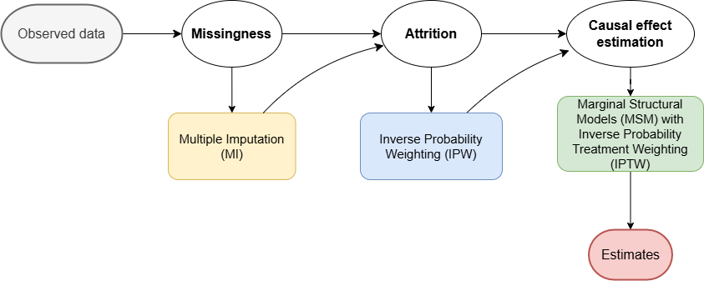
Methods – Design of Integrated Model
A simulation study will be conducted to tune the integrated model and check its statistical properties.
Notes:
A simulation study will be conducted to tune the integrated model and check its statistical properties. As the workflow diagram shows, we will handle missingness by using MI first and then calculate IPPW to address attrition; finally, MSM with IPTW will give the causal effect estimates.

Slide 14
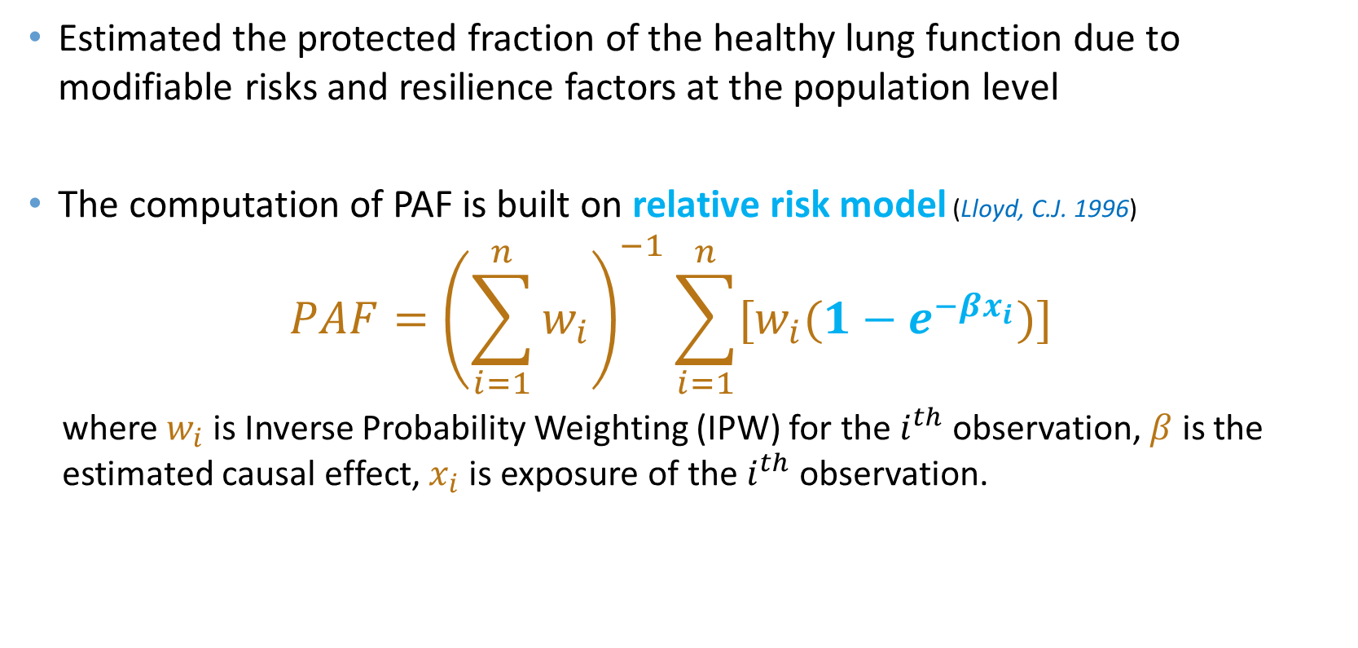
Methods – Population Attributable Fractions (PAF)
Estimated the protected fraction of the healthy lung function due to modifiable risks and resilience factors at the population level
The computation of PAF is built on relative risk model (Lloyd, C.J. 1996)
$$PAF={\left(\sum_{i=1}^{n}{w_{i}}\right)}^{−1}\sum_{i=1}^{n}{[w_{i}(1−e^{−βx_{i}})]}$$
where$w_{i}$ is Inverse Probability Weighting (IPW) for the $i^{th}$ observation, $β$ is the estimated causal effect, $x_{i}$ is exposure of the $i^{th}$ observation.
Notes:
Lastly, we will estimate the protected fraction of the healthy lung function due to modifiable risks and resilience factors at the population level.

Slide 15
Research Gap
Methodology - Concentrate on integrating IPW to deal with unit-level missingness (i.e., attrition), MI to deal with item-level missingness, and MSM with IPTW to enable causal inference.
Substantive - Conduct a full causal analysis of the impact of early childhood factors on the Pacific youth respiratory health using the PIFS cohort data.
Notes:
The research gap in this study is,
in methodology, we will concentrate on an integrated model with IPW to deal with unit-level missingness, MI to deal with item-level missingness, and MSM to enable causal inference
In substantive, we will conduct a full causal analysis of the impact of early childhood factors on the respiratory health of Pacific youth using the PIFS cohort data.

Slide 16
Simulation - Settings
Reference variables are needed to make the simulation close to the PIFS data.
Reference variables are picked up from initial (6-weeks) measurement wave, 4-years-old measurement wave, and 9-years-old measurement wave
Reference coefficients are rounded to one decimal place
 | Simulation setting | Reference measurement wave
l0: Baseline characteristics | Mother’s birth age | Initial (6-weeks)
z1 & z2: Time-varying confounder | Smoking exposure | 4-years-old & 9-years-old
t1 & t2: Exposure | Allergies | 4-years-old & 9-years-old
y1 & y2: Outcome | Problems with Asthma | 4-years-old & 9-years-old
u1 & u2: Unobserved confounder | N/A | N/A
Notes:
To make the simulation behave similarly to the actual data, we use some reference variables from the PIFS cohort. They are picked up from initial wave, 4-years-old wave, and 9-years-old wave. Furthermore, reference coefficients are rounded to one decimal place to facilitate comparison within simulation results.

Slide 17
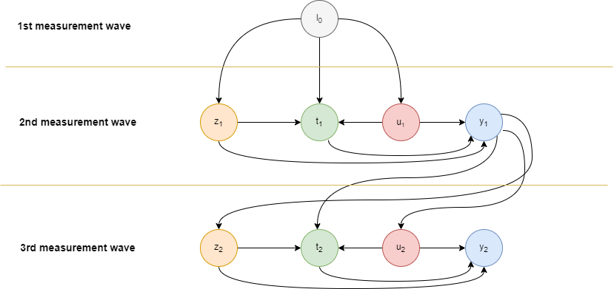
Simulation – 3-layers Causal Diagram
Notes:
Here is the causal diagram for the simulation. It has three measurement waves.
To make simulation results easy to validate, we assume that only baseline characteristics are obtained in the first wave, and causal effects in the second wave are passed through to the third wave only via y1.
We are also interested in the impact of unobserved confounders on causal effect estimates, so unobserved confounders will be introduced in the last stage of the simulation.

Slide 18
Simulation – Estimates (Imputation model: t1 ~ l0+z1+y1)
Relative risk | y1 ~ t1 est. | y2 ~ t1 est. | y2 ~ t2 est.
True value | 0.25 |  | 0.90
Complete data | 0.2474 (s.e.: 0.0012) | -0.0022 (s.e.: 0.0014) | 0.8990 (s.e.: 0.0011)
MCAR attrition only | 0.2460 (s.e.: 0.0013) | -0.0093 (s.e.: 0.0021) | 0.8967 (s.e.: 0.0016)
MAR attrition only | 0.2455 (s.e.: 0.0014) | -0.0042 (s.e.: 0.0018) | 0.8984 (s.e.: 0.0014)
MNAR attrition only | 0.2470 (s.e.: 0.0013) | -0.0065 (s.e.: 0.0021) | 0.8982 (s.e.: 0.0017)
MCAR missingness only | 0.2454 (s.e.: 0.0013) | -0.0016 (s.e.: 0.0013) | 0.8960 (s.e.: 0.0015)
MAR missingness only | 0.2445 (s.e.: 0.0014) | -0.0013 (s.e.: 0.0013) | 0.8980 (s.e.: 0.0012)
MNAR missingness only | 0.2468 (s.e.: 0.0014) | 0.0005 (s.e.: 0.0011) | 0.9254 (s.e.: 0.0016)
MCAR attrition + MCAR missingness | 0.2444 (s.e.: 0.0015) | -0.0089 (s.e.: 0.0019) | 0.8934 (s.e.: 0.0022)
MAR attrition + MAR missingness | 0.2418 (s.e.: 0.0017) | -0.0049 (s.e.: 0.0016) | 0.8980 (s.e.: 0.0016)
MNAR attrition + MNAR missingness | 0.2472 (s.e.: 0.0016) | -0.0013 (s.e.: 0.0016) | 0.9339 (s.e.: 0.0025)
Notes:
As we can see from the table, the estimates are underestimates but quite close to the true value in most scenarios, and attrition and missingness `will decrease the effective of the sample size. (conjecture).
But there are two exceptions and we don’t have explanation for them so far. It may be because of the MNAR mechanism.
Monte Carlo.

Slide 19
Simulation – Bias Source in Causal Effect Estimate
Sample size
Non-collapsibility (Daniel, R., Zhang, J., & Farewell, D. (2021)) - Marginal causal effect estimate will be biased when characteristic collapsibility function (CCF) of link function is non-linear (e.g., logit link).
Link function boundary - Boundary exists in some link functions (e.g., log link, logit link). - Causal effect estimates are biased if lots of probabilities lie at the boundary.
Notes:
As we can observe, some bias exists in estimates. It is majorly due to sample size, non-collapsibility, and link function boundary.
To replicate the PIFS cohort, we set the sample size of simulation at 1500, which is not a big sample size.
Marginal causal effect estimate will be biased when characteristic collapsibility function (CCF) of link function is non-linear.
Lastly, a boundary exists in some link functions (e.g., log link, logit link). Causal effect estimates are biased if lots of probabilities lie at the boundary. We optimize coefficients being used in the data generation and rely on the reference variables to avoid this phenomenon.

Slide 20
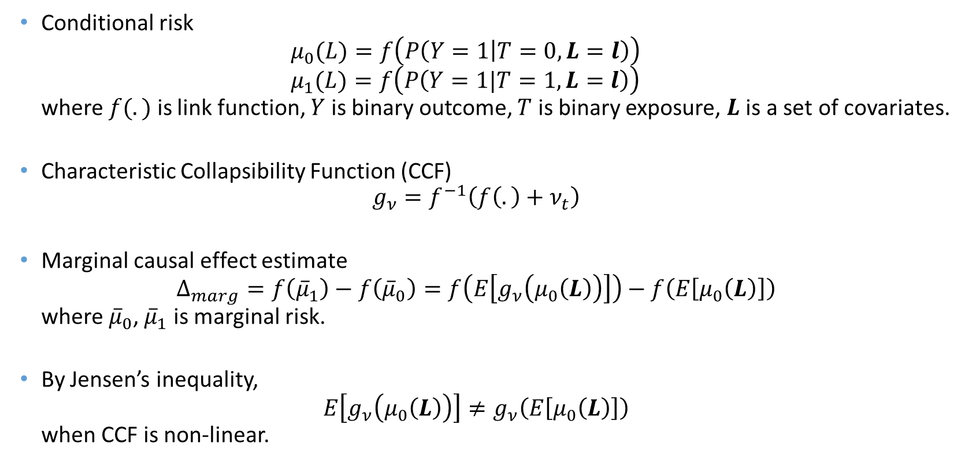
Simulation – Non-collapsibility
Conditional risk $μ_{0}(L)=f\left(P\left(Y=1 | T=0,L=l\right)\right)$ $μ_{1}(L)=f\left(P\left(Y=1|T=1,L=l\right)\right)$ where $f(.)$ is link function, $Y$ is binary outcome, $T$ is binary exposure, $L$ is a set of covariates.
Characteristic Collapsibility Function (CCF) $g_{ν}=f^{−1}\left(f\left(.\right)+ν_{t}\right)$
Marginal causal effect estimate $Δ_{marg}=f\left({\overline{μ}}_{1}\right)−f\left({\overline{μ}}_{0}\right)=f\left(E\left[g_{ν}\left(μ_{0}\left(L\right)\right)\right]\right)−f\left(E\left[μ_{0}\left(L\right)\right]\right)$ where ${\overline{μ}}_{0}$, ${\overline{μ}}_{1}$ is marginal risk.
By Jensen’s inequality, $E\left[g_{ν}\left(μ_{0}\left(L\right)\right)\right]≠g_{ν}\left(E\left[μ_{0}\left(L\right)\right]\right)$ when CCF is non-linear.
Notes:
This slide introduces the mathematical explanation for non-collapsibility.
As we can see, by using CCF, the marginal risk of the intervention group can be represented by a function that depends on the marginal risk of the control group.
Jensen’s inequality holds when CCF of the link function is non-linear, and this will lead to bias in marginal causal effect estimate. CCF is linear when the link function is identity or log.

Slide 21
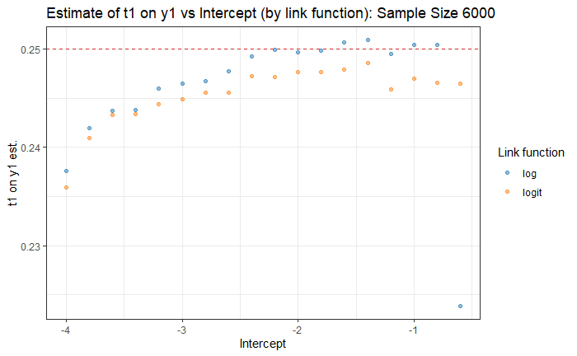
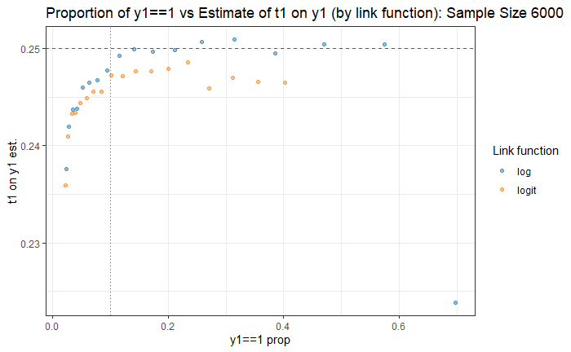
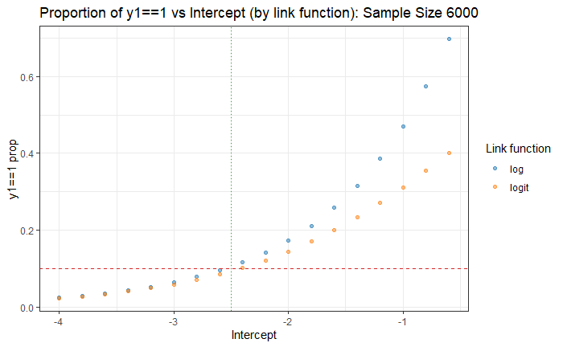

Simulation – Log Link and Logit Link Examples
Logit link CCF is concave, so $$E\left[g_{ν}\left(μ_{0}\left(L\right)\right)\right]≤g_{ν}\left(E\left[μ_{0}\left(L\right)\right]\right)$$
Notes:
Here is the example. From the plots, estimates become stable after the proportion of y1==1 is larger than 10%. This unstable status in the estimation is because of the link function boundary. We can also find that non-collapsibility makes estimates from log link be closer to the true value compared to logit link after stability is achieved.

Slide 22
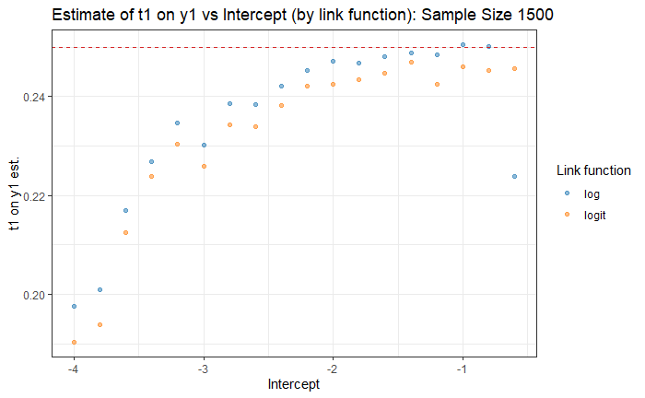
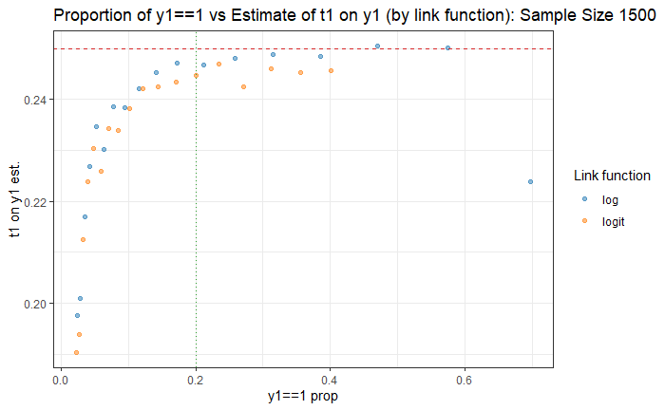
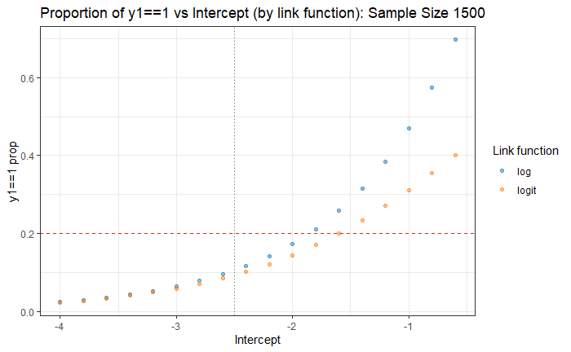
Simulation – Log Link and Logit Link Examples (cont.)
Notes:
And then, we look at plots generated by a smaller sample size. It achieves stable later. Additionally, the gap between log link and logit link become smaller. This is because the estimation error becomes large when sample size decreases, and this larger error masks the non-collapsibility gap.

Slide 23
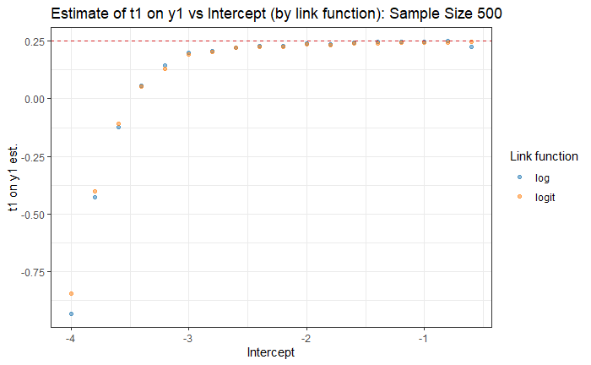
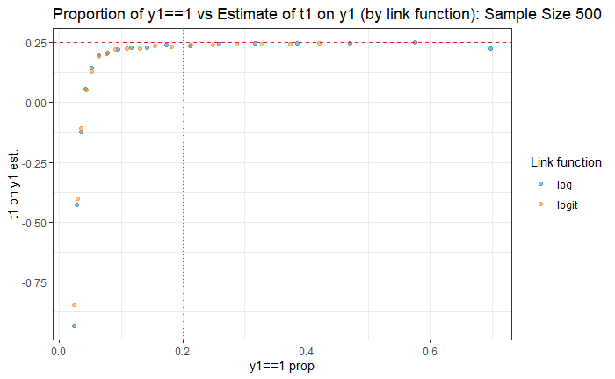
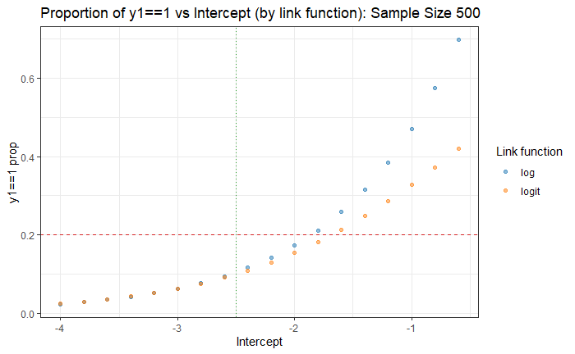
Simulation – Log Link and Logit Link Examples (cont.)
Notes:
As the sample size reduces to 500, the estimates produced by the log link and logit link converge closely, and the gap nearly vanishes.

Slide 24
Q & A

Slide 25
References
Riley, L., & Cowan, M. (2014). World Health Organization noncommunicable diseases country profiles. Geneva, Switzerland: WHO Library Cataloguing-in-Publication Data, 156-165.
Paterson, J., Percival, T., Schluter, P., Sundborn, G., Abbott, M., Carter, S., Cowley-Malcolm, E., Borrows, J., Gao, W., & Group, P. S. (2008). Cohort profile: the Pacific Islands Families (PIF) study. International Journal of Epidemiology, 37(2), 273–279. 23
Seaman, S. R., White, I. R., Copas, A. J., & Li, L. (2012). Combining multiple imputation and inverse-probability weighting. Biometrics, 68 (1), 129–137.
Leyrat, C., Seaman, S. R., White, I. R., Douglas, I., Smeeth, L., Kim, J., Resche-Rigon, M., Carpenter, J. R., & Williamson, E. J. (2019). Propensity score analysis with partially observed covariates: How should multiple imputation be used? Statistical methods in medical research, 28 (1), 3–19.
Leyrat, C., Carpenter, J. R., Bailly, S., & Williamson, E. J. (2021). Common methods for handling missing data in marginal structural models: What works and why. American Journal of Epidemiology, 190 (4), 663–672.
Lloyd, C.J. (1996). Estimating attributable response as a function of a continuous risk factor. Biometrika, 83, 563–573.
Daniel, R., Zhang, J., & Farewell, D. (2021). Making apples from oranges: Comparing noncollapsible effectestimators and their standard errors after adjustment for different covariate sets. Biometrical Journal,63(3), 528–557.

